Slide 1
Normal forms
DNF – Disjunctive Normal form
Cnf- conjunctive normal form
Pdnf – principal disjunctive normal forms
Pcnf – principa conjunctive normal forms

Slide 2
Why?
A statement formula evaluated can be
Tautology
Contradiction
Satisfiable
The problem of determining whether a formula is tautology or contradiction or satisfiable is decision problem
Construct truth tables or by using laws like de-morgans law, equivalence laws etc
Thus, reduce to Normal forms

Slide 3
Disjunctive Normal forms
Elementary product
A product of variables and their negations in a formula
P, Q, ~P ^ Q, ~Q ^ P ^ ~P, ~P ^ ~Q, P ^ ~P- Contradiction
Elementary Sum
A sum of variables and their negations in a formula
P, Q, ~P V Q, ~Q V P V ~P, ~P V ~ Q, P V~P – tautology

Slide 4
Disjunctive Normal forms
A formula which is equivalent to a given formula and which consists of a sum of elementary products
~ P Λ ~ Q, P Λ ~Q, ~P Λ Q-elementary products
(P ^ ~ Q) V ( P ^ ~ P) – Sum of elementary products
( ~P ^ Q) V (Q ^ P)

Slide 5
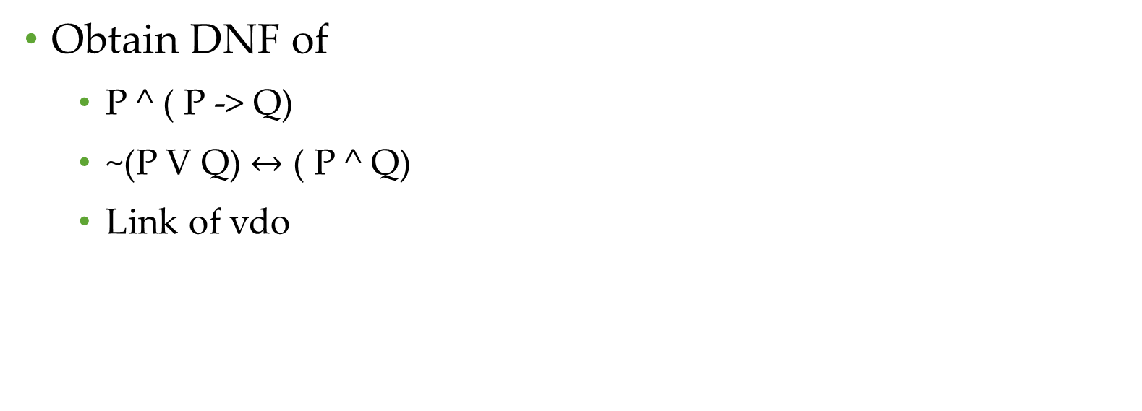
Obtain DNF of
P ^ ( P -> Q)
~(P V Q) $↔$ ( P ^ Q)
Link of vdo

Slide 6
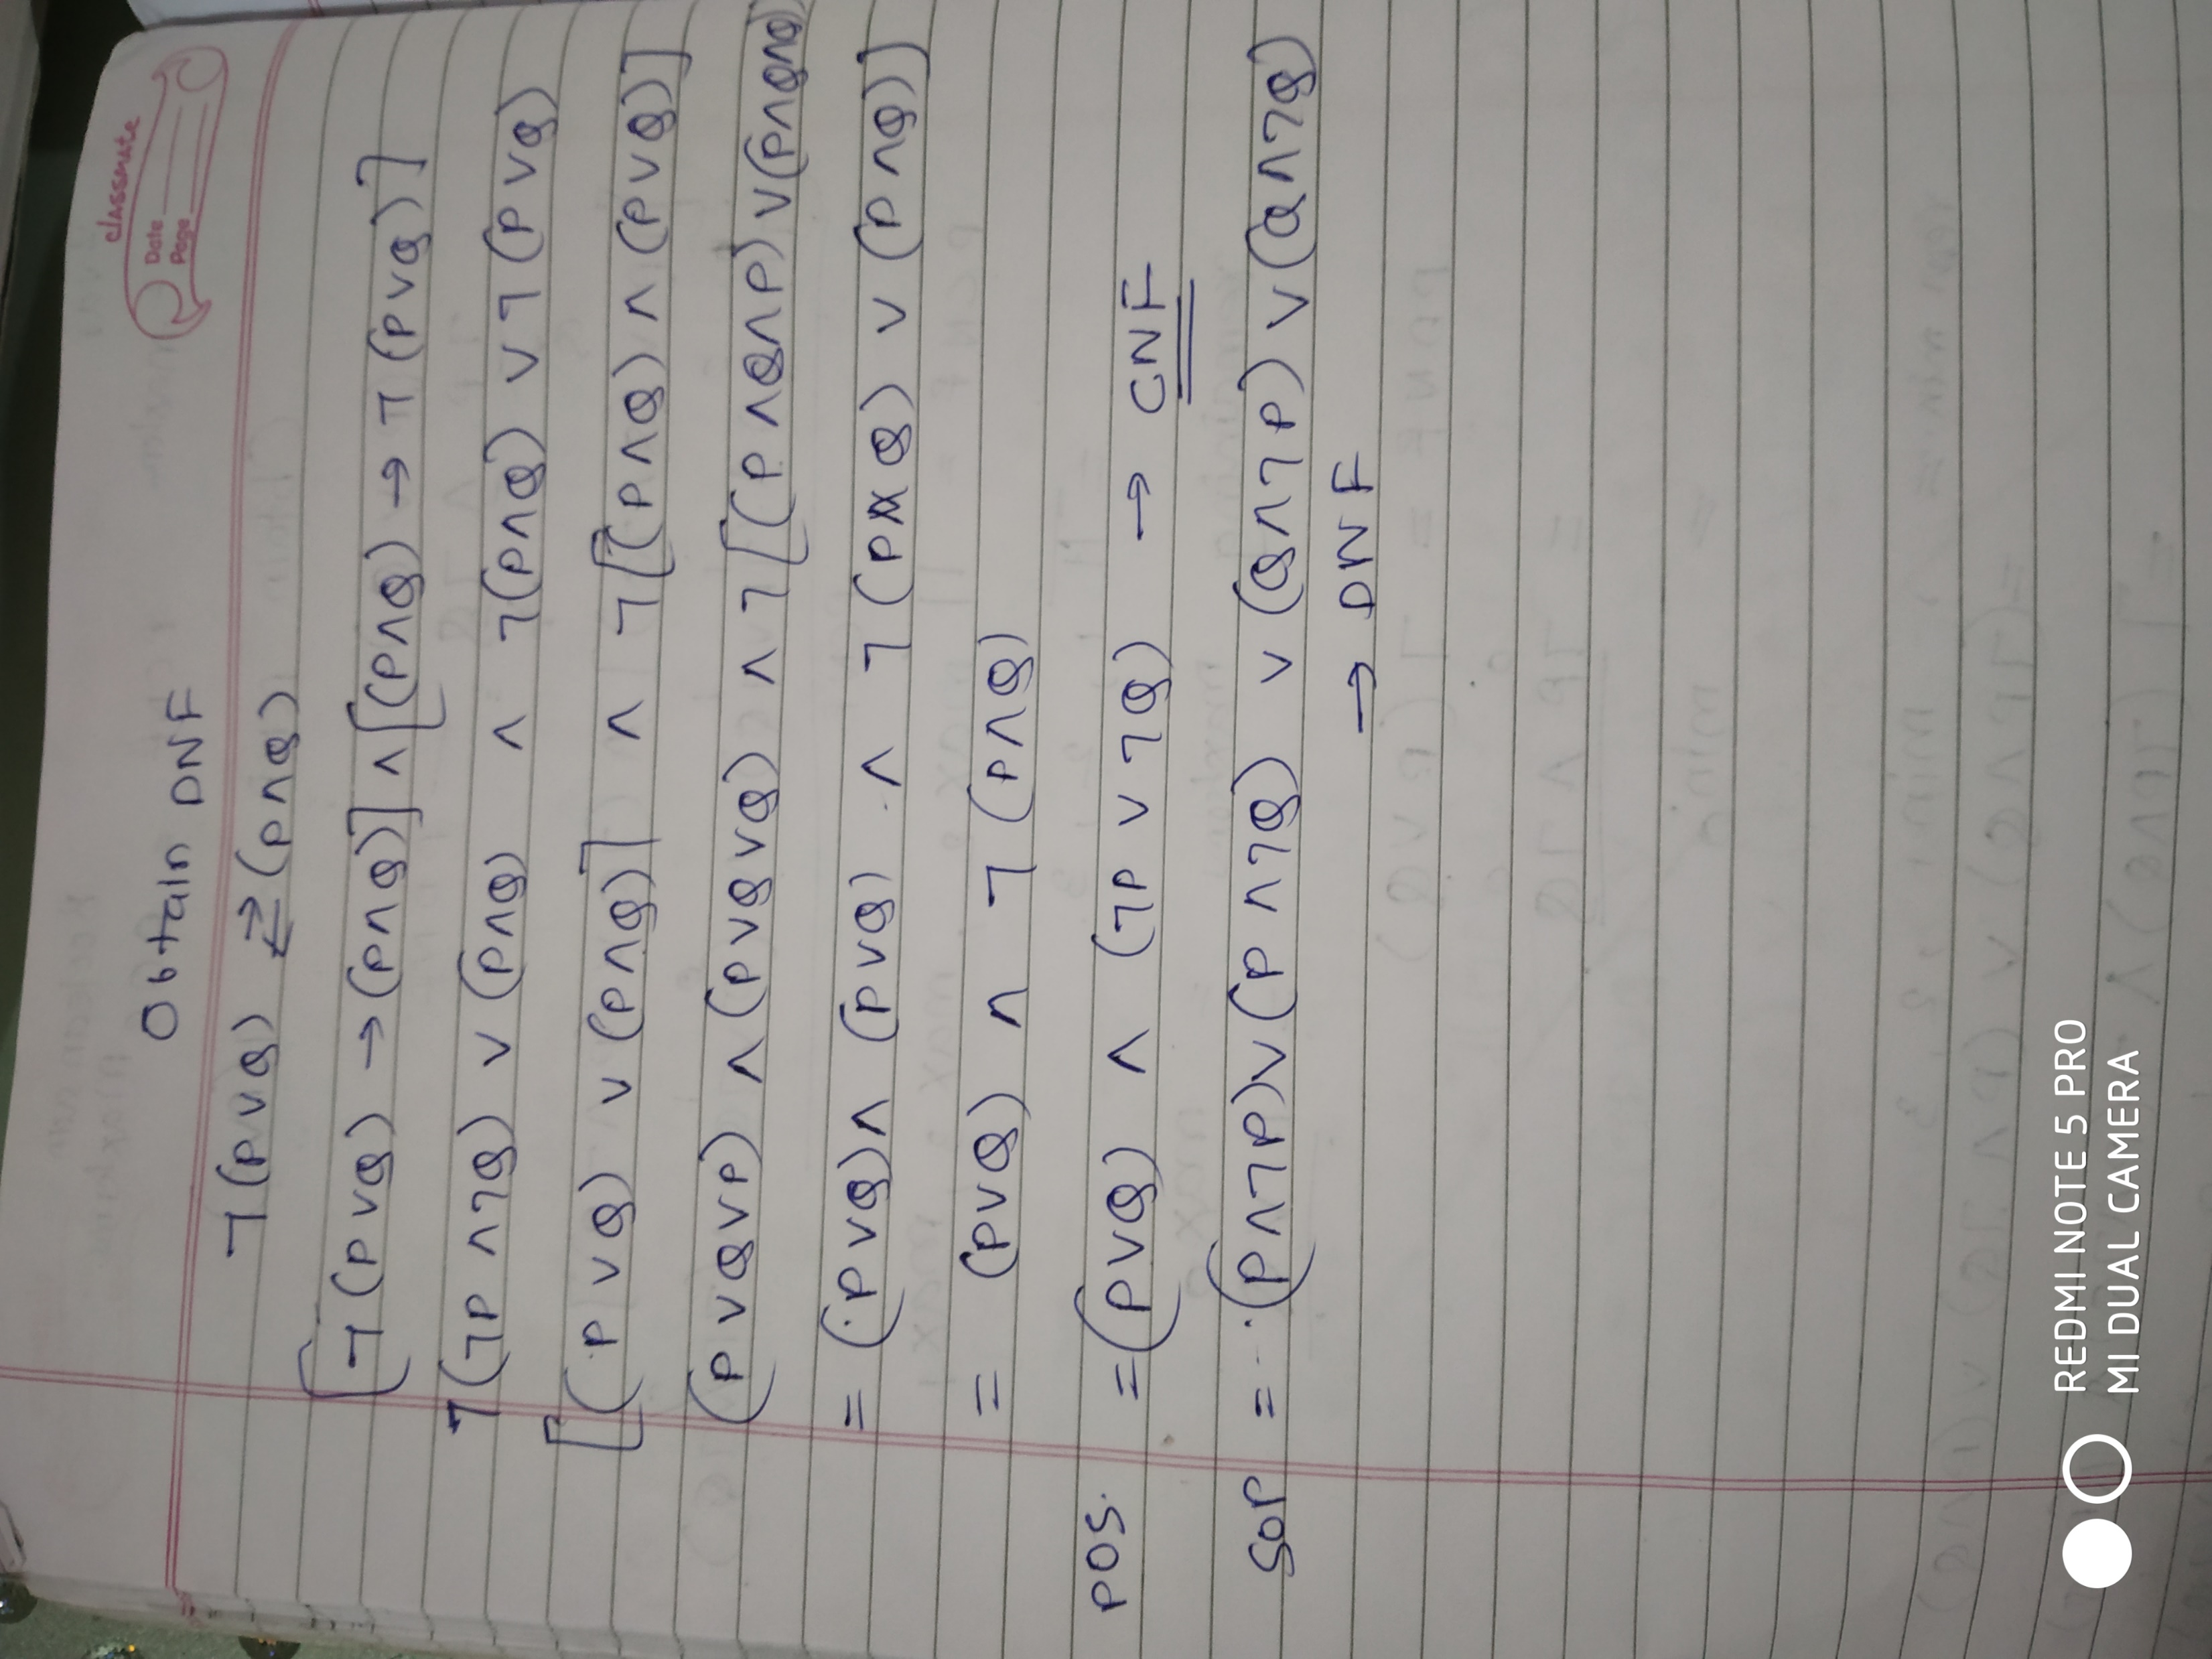

Slide 7
Conjunctive Normal form
A formula which is equivalent to a given formula and which consists of a product of elementary sums
(P V ~Q) ^ ( P V ~P)
(P V ~P) ^ Q

Slide 8
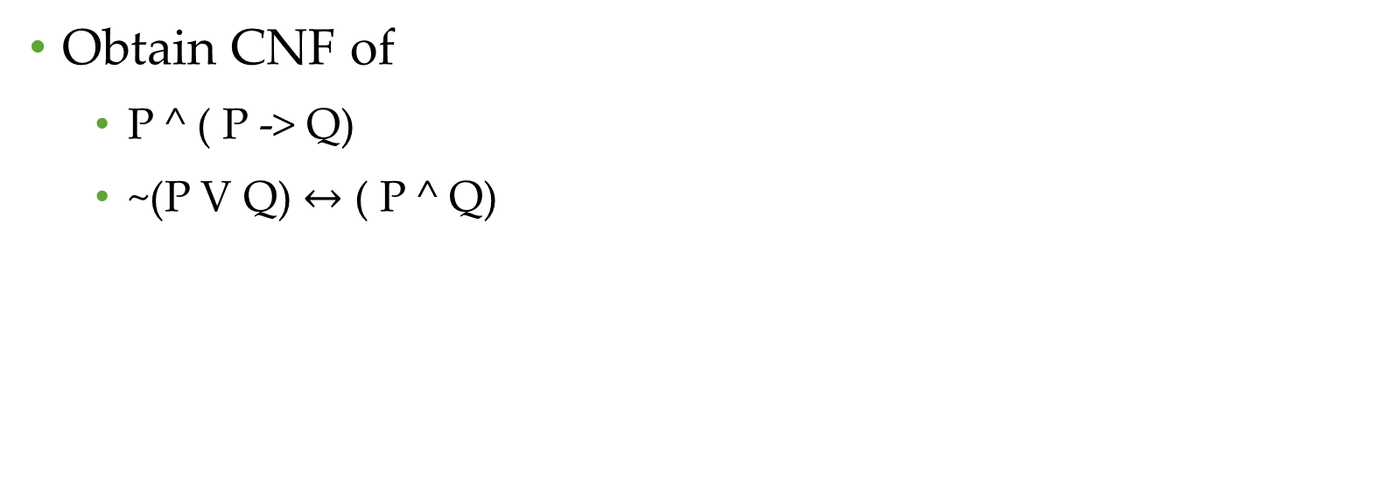
Obtain CNF of
P ^ ( P -> Q)
~(P V Q) $↔$ ( P ^ Q)

Slide 9
Principal disjunctive normal form(PDNF)
A statement which consists of a sum of products canonical form.
For a given formula, an equivalent formula consisting of disjunctions of minterms only This form is not unique for the given statement.

Slide 10
Minterms
Let P and Q be two propositional variables.
All possible formulas which consist of product of P or its negation and product of Q or its negation, but should not contain both the variable and its negation in any one of the formula are called minterms of P and Q.
Eg: For two variables P and Q, there are 2² = 4 minterms, namely,
PΛQ T T
PΛ~Q TF
~PΛQ FT
~PΛ~Q FF

Slide 11
Principal disjunctive normal form(PDNF)
Procedure I: For every truth table T in the truth table of the given statement, choose the minterm which also has the value T for the same combination of the truth values of p and q. The sum of these minterms will then be equivalent to the given statement.

Slide 12

Principal disjunctive normal form(PDNF)
P Λ Q - minterm

Slide 13

Principal disjunctive normal form(PDNF)
All three true values will be considered for PDNF
(P Λ Q ) V ( P Λ ~ Q) V ( ~P Λ Q) – PDNF from truth table

Slide 14
Procedure 2.
1. Obtain DNF
2. Drop elementary products, which are contradictions such as (PΛ~P)
3. Add the missing factors by anding with tautology of missing variable
Λ ( Q V ~ Q)
4. Repeat step 3 until all elementary products are reduced to sum of minterms. Use idempotent laws to avoid repetitions of minterms.

Slide 15
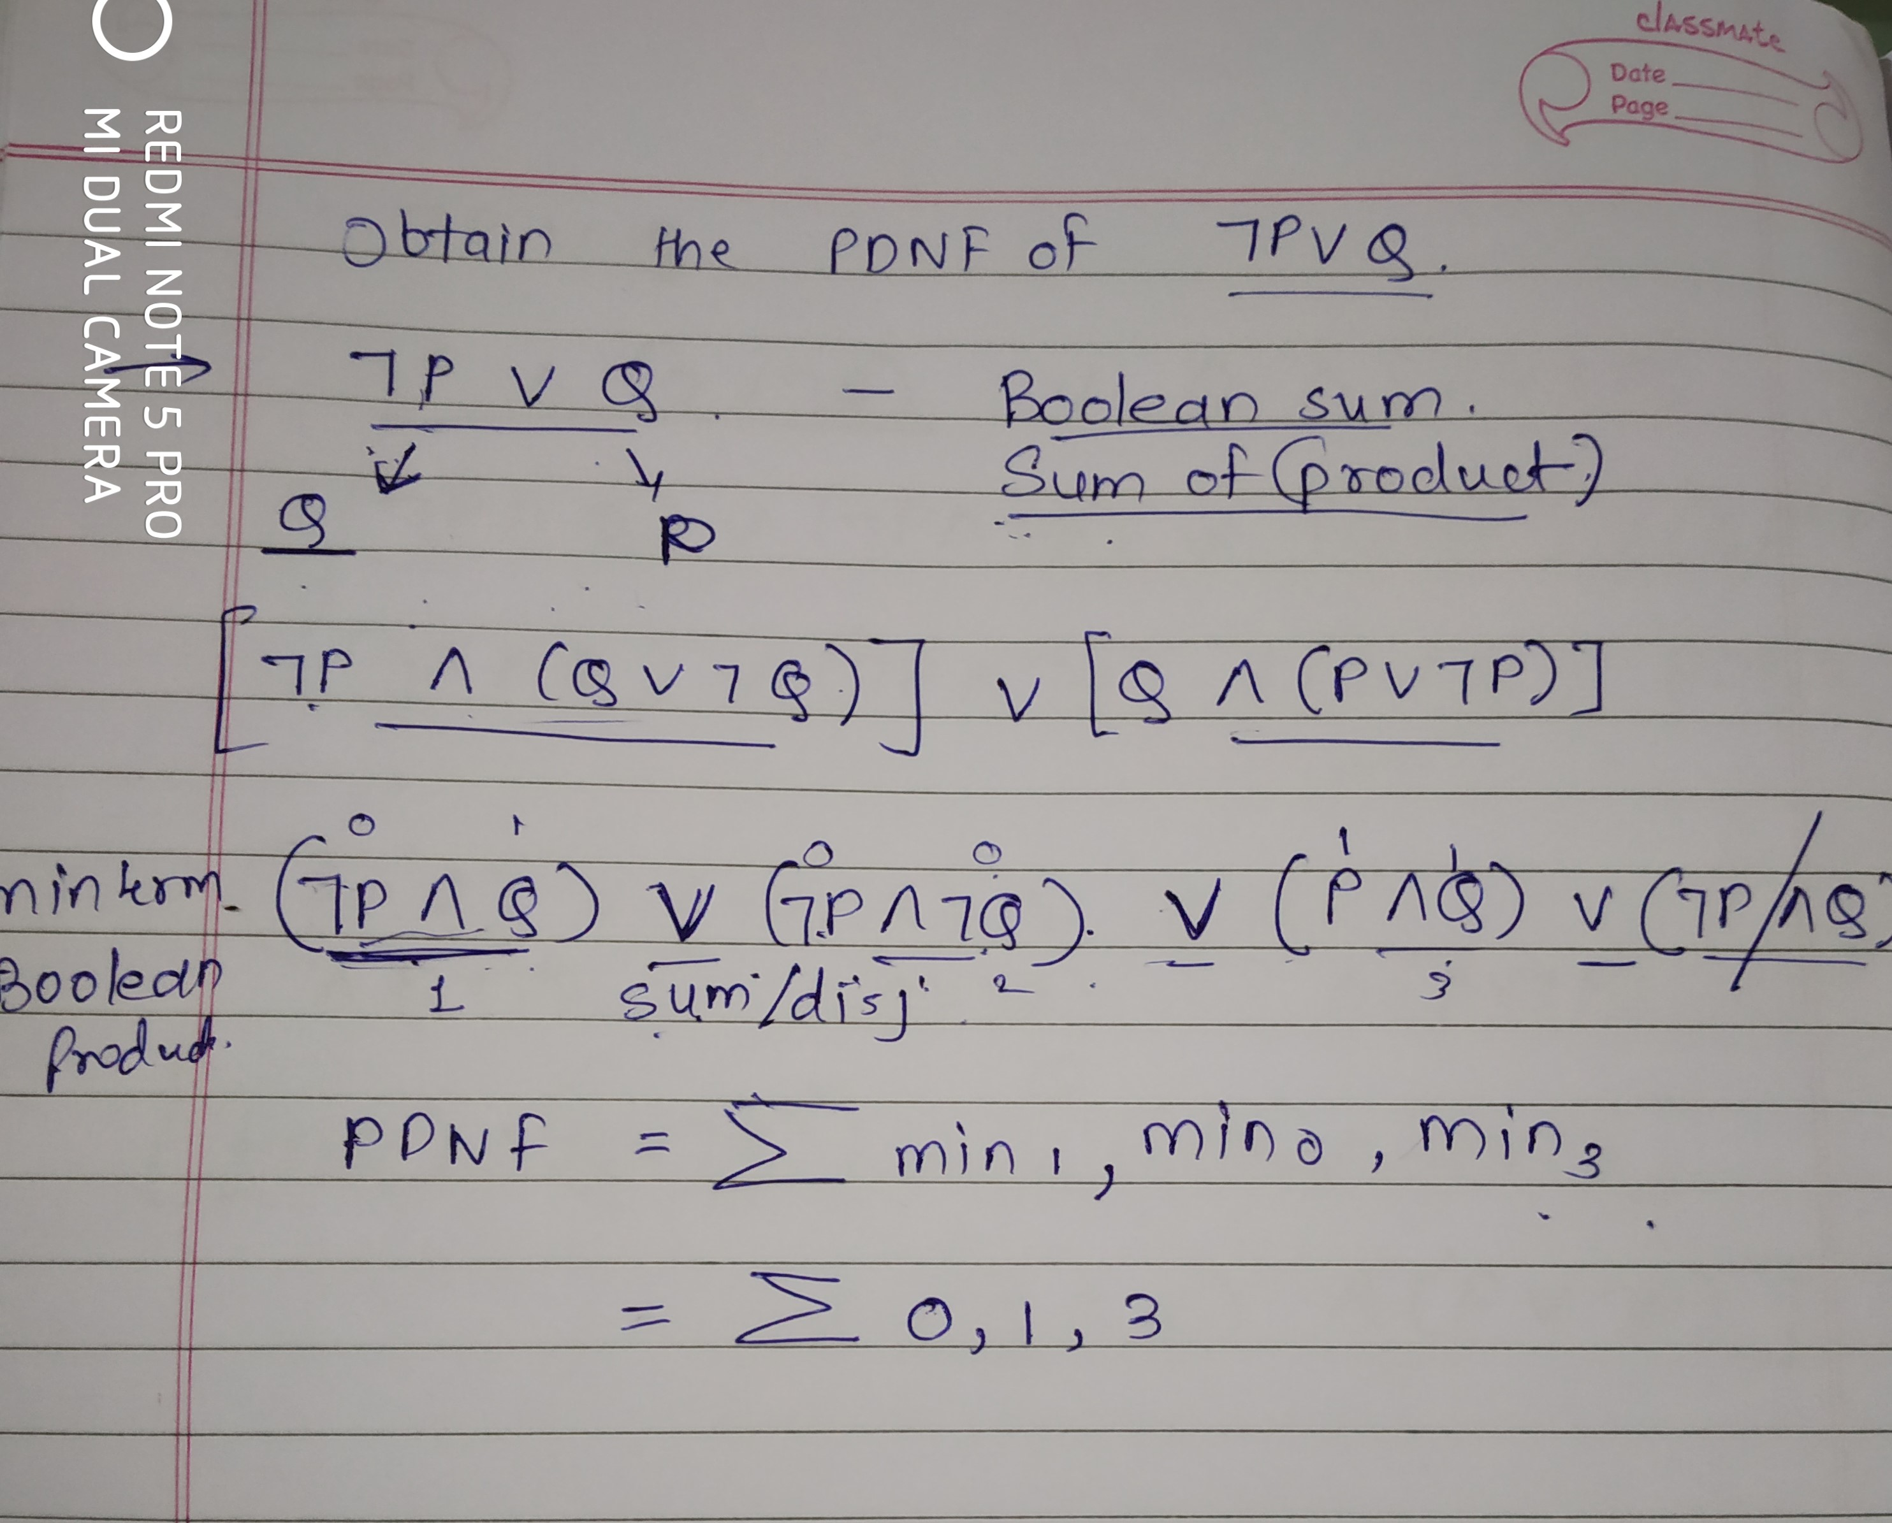

Slide 16
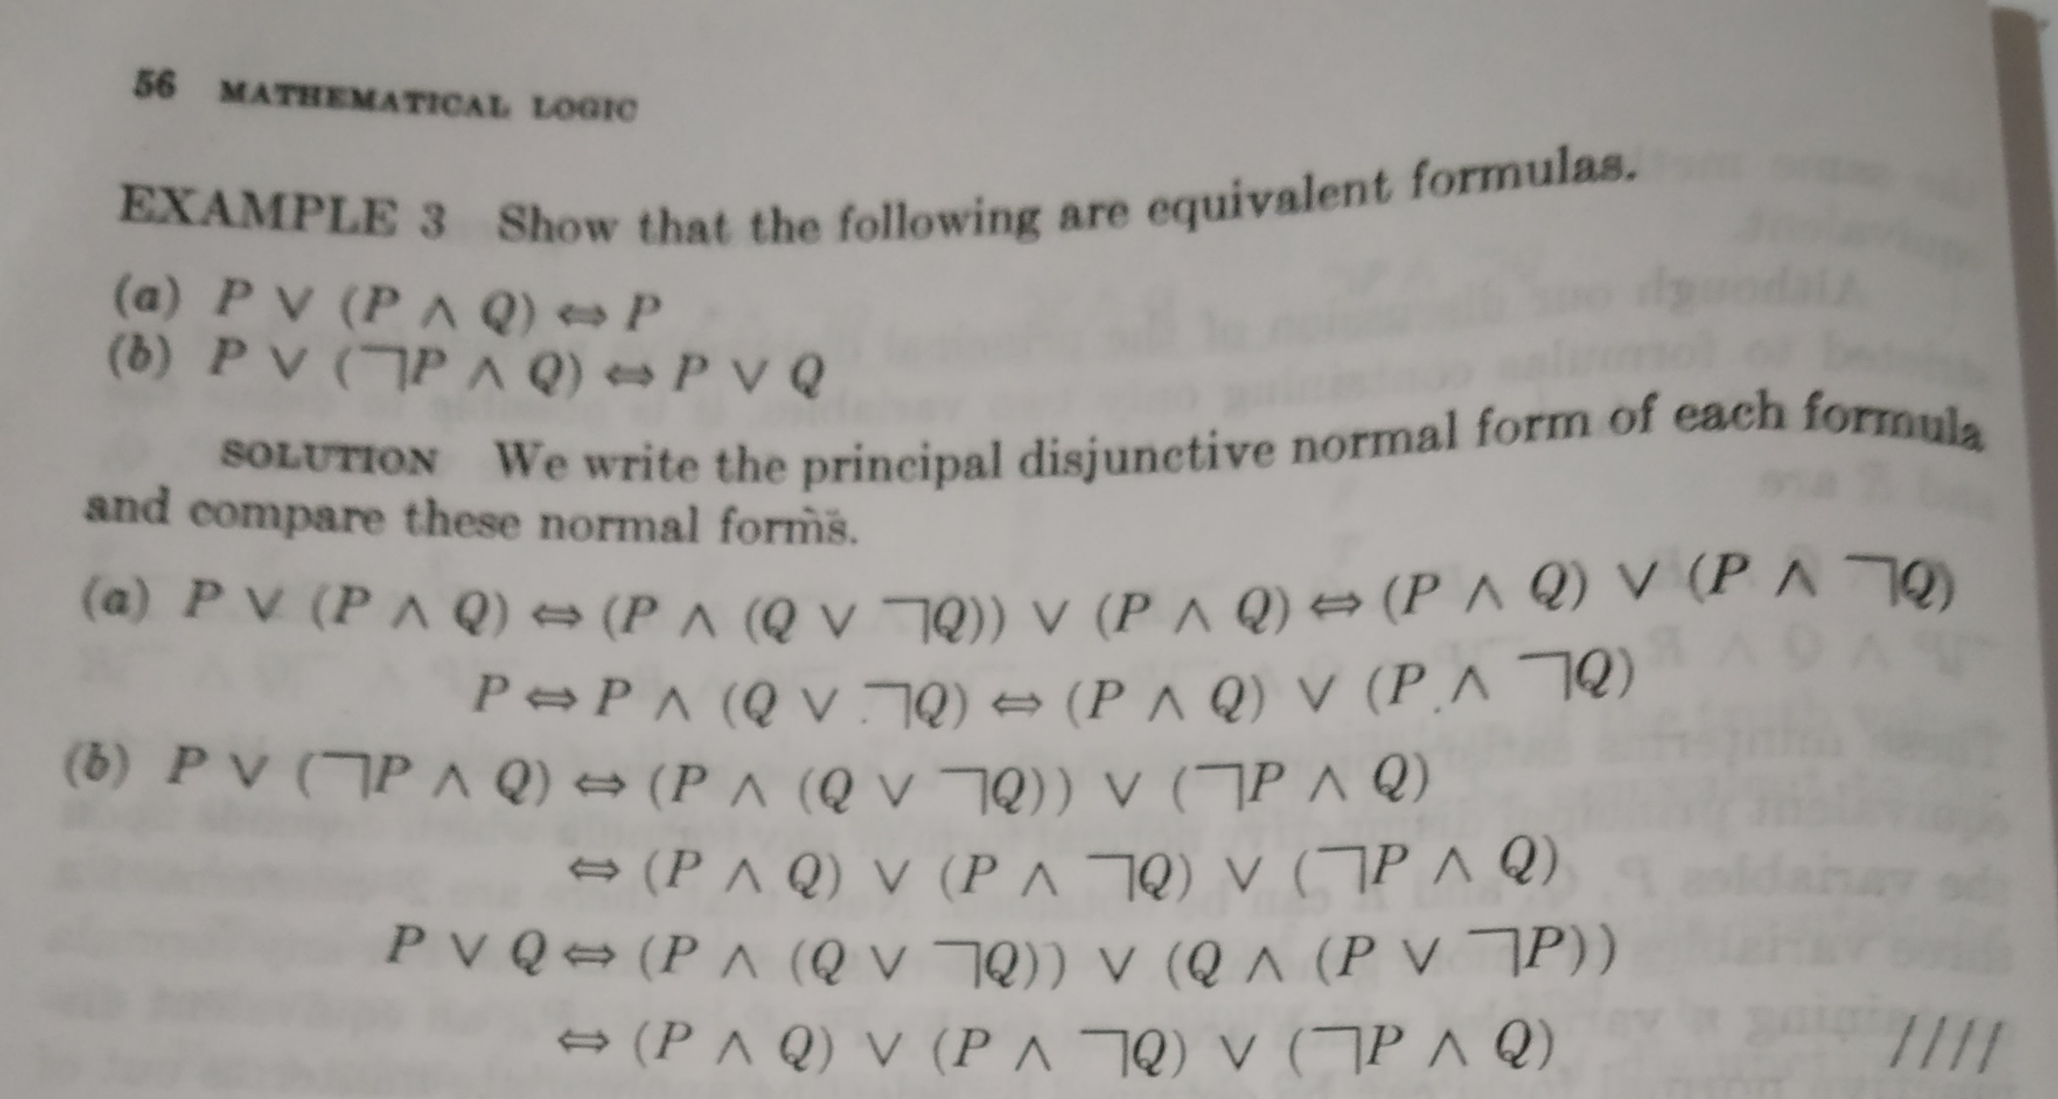

Slide 17
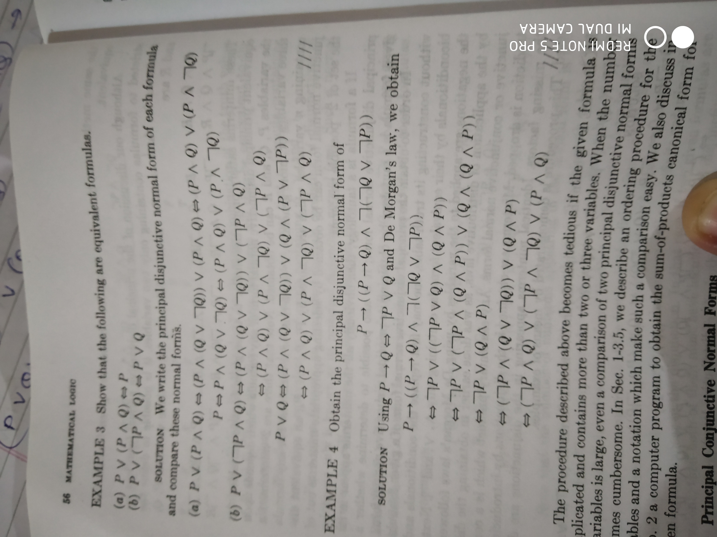

Slide 18
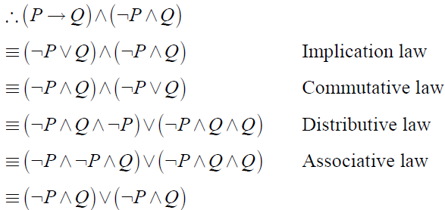
Obtain PDNF

Slide 19
Principal conjunctive normal form(PCNF)
Product of Sums canonical form
For a given formula, an equivalent formula consisting of conjunctions of maxterms only This form is not unique for the given statement.

Slide 20
Maxterms
Let p and q be two propositional variables.
All possible formulas which consist of Sum of P or its negation and Sum of Q or its negation, but should not contain both the variable and its negation in any one of the formula are called Maxterm of P and Q.
Eg: For two variables P and Q, there are 2² = 4 maxterms, namely,
P V Q,
PV~Q,
~PVQ,
~PV~Q.

Slide 21
Principal conjunctive normal form(PCNF)
Procedure1: For every truth table F in the truth table of the given statement, choose the maxterm which also has the value F for the same combination of the truth values of p and q. The product of these maxterms will then be equivalent to the given statement.

Slide 22
All three false values will be considered for PCNF
(~P V Q) ^ ( P V ~Q) ^ (P V Q) - PCNF

Slide 23
Principal conjunctive normal form(PCNF)
If the PDNF (or PCNF) of a given statement S, containing n variables, is known then the PDNF (or PCNF) of ~S will consist of the disjunction (conjunction) of remaining minterms (or maxterms) which are not present in the PDNF (or PCNF) of S.
Since S≈b~(~S), so we can obtain the PCNF (or PDNF) of S by applying De Morgan’s Laws.

